Slide 1


Data-Driven Storytelling Presentation
Virtual Experience Hypothetical Account Dataset
Harsh Kumar

Slide 2
Introduction
JP Morgan is a global financial services firm that provides a wide range of banking, investment, and asset management services to individuals, corporations, governments, and institutions worldwide.
The Virtual Experience Hypothetical Account Dataset provided by JP Morgan is likely a simulated dataset created by JP Morgan for educational or training purposes. It may contain fictional or anonymized financial data designed to simulate real-world scenarios and allow users to gain practical experience in financial analysis, data interpretation, and decision-making within a controlled environment.
Unlock insights and drive growth with JP Morgan's Virtual Experience Hypothetical Account Dataset! Dive into the last 5 years (2017-2021) of account performance, powered by Compound Annual Growth Rate (CAGR) data in unit sales. Discover trends, spot opportunities, and chart a course for improvement. Let the numbers guide you to success!

Slide 3
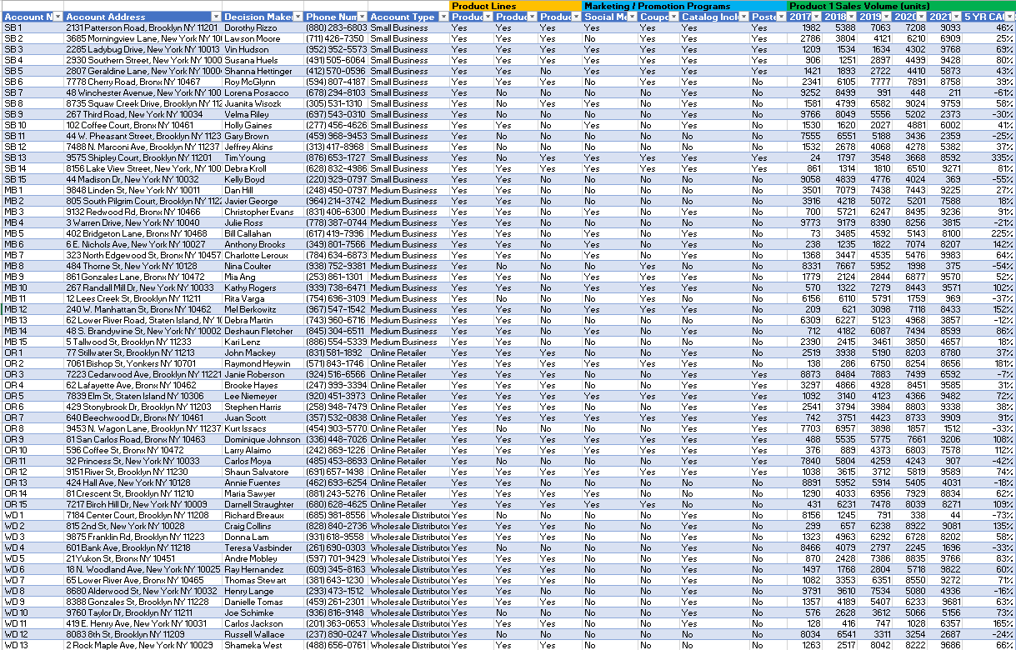
Excel Your Analysis: Peek Inside JP Morgan's Dataset! Unveiling 5 years of account performance in a snapshot.

Slide 4
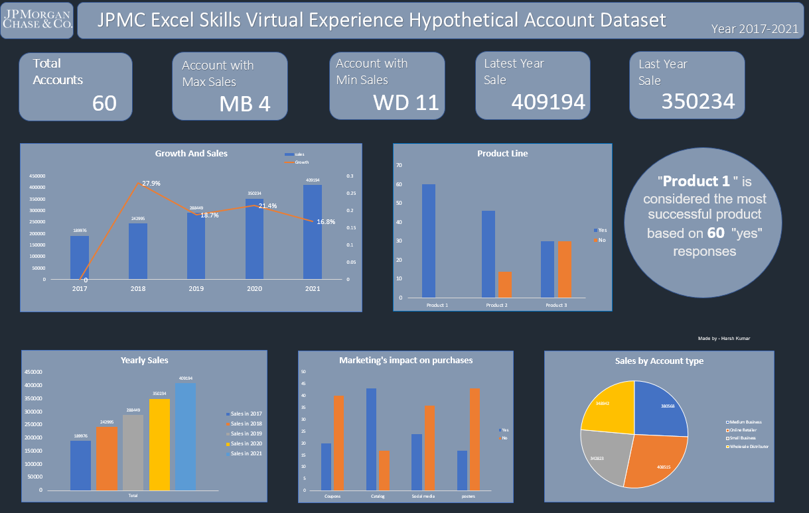
Dashboard

Slide 5
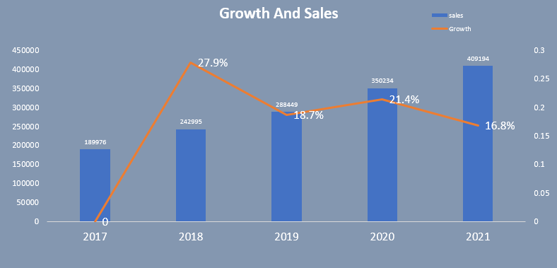
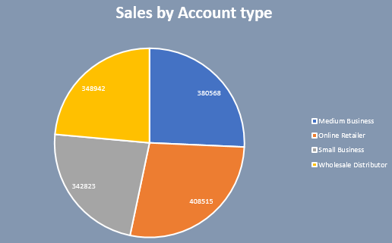
Data Analysis & Visualization
Charting Success: 2018 Peaks! Sales soar while growth rates hit a high of 27.9%. Unleash the power of data-driven decisions.
Sales Spectrum: Online Retail Reigns! Explore sales distribution across medium, online, small, and wholesale businesses, with online retail leading the pack at 408,515 units sold.

Slide 6
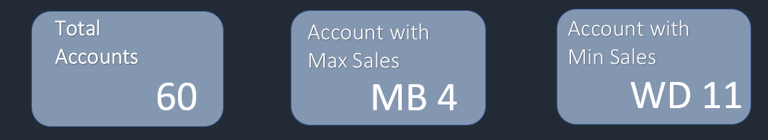
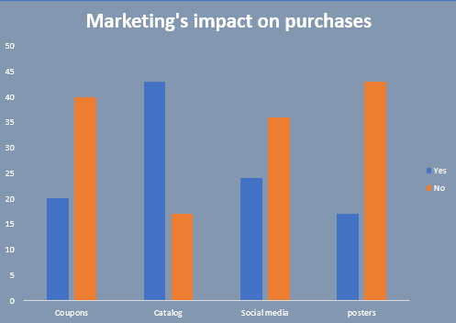
Data Analysis & Visualization
Extreme Ends of the Spectrum: MB 4 Tops the Charts, While WD 11 Takes the Bottom Spot in our 60-Account Dataset
Unveiling Marketing's Influence: Exploring Its Impact on Purchases Through Graphical Analysis

Slide 7
Summary
Our analysis of 60 accounts highlights the substantial influence of marketing on purchase behavior.
Graphs reveal clear trends, guiding strategic decisions
MB 4 shines as a marketing success story.
WD 11 highlights areas for optimization
Insightful Dashboard: Unveiling Key Data for Informed Decision-Making.
Actionable Advice
Investigate Growth Peaks: Analyze factors driving peak growth, especially in 2018, for insights.
Streamline Accounts: Discontinue non-profitable accounts to optimize resources.
Online Retail Focus: Allocate resources to strengthen online retail channels.
Revamp Marketing: Improve marketing with passion and innovation, discontinuing outdated methods.

